Slide 1
Budget Planner
[WEB TECHNOLOGY BASED MINI - PROJECT]
Budget Planner is a smart application that allows users to record income, track expenses and manage their budget efficiently, helping them gain better control over their personal finances.
Team Name - BudgetMates
Members: Roll Number:
Devendra Singh 2400520100033
Ayushman Agrahari 2400520100027
Aditya Panday 2400520100010
Aryan Shukla 2400520100023
Ankush Singh 2400520100015

Slide 2
Problem Statement
Many people struggle to manage their personal finances because they do not track their daily income and expenses properly. This results in overspending and poor savings management. Hence, there is a need for simple and efficient budgeting system.
Problems faced by people:
lack of proper tracking of daily income and expenses
overspending due to poor budget planning
no clear record of monthly savings
difficulty in categorizing expenses (food, travel, bills, etc.)
manual calculations leading to errors
no visual analysis of spending patterns
poor financial discipline and planning
difficulty in setting and achieving savings goals

Slide 3
Solution - Budget Planner
Core Functionalities:
Real-Time Tracking -> Effortlessly log both income and daily expenses as they occur for an up-to-date balance.
Smart Categorization -> Automatically group spending into categories like Food, Transport, and Utilities to see exactly where money goes.
Comprehensive Summaries -> Generate monthly reports to visualize total inflow versus outflow at a glance.
User Benefits & Impact:
Financial Discipline -> Encourages mindful spending habits specifically tailored for students and busy individuals.
Goal-Oriented Planning -> Provides the visibility needed to set and reach specific financial saving targets.
User-Centric Design -> A simplified platform that removes the stress of manual financial management.

Slide 4
Comparison
S.No. | Features | Existing Apps | Budget Planner
1. | User Interface | Complex and cluttered❌ | Simple and intuitive✅
2. | Cost | Often includes paid features❌ | Completely free to use✅
3. | Ads | Frequently contains too many ads❌ | Clean, ad-free design✅

Slide 5
Tools & Technologies Used
Development Stack:
Frontend - Built using React.js, HTML, and CSS for a responsive and modern user interface.
Backend - Powered by Flask (web framework written in Python) to handle application logic, routing, and API requests.
Database - Utilizes Local Storage or MongoDB for efficient data persistence and storage.
Version Control - Managed via GitHub for tracking changes and collaborative development.

Slide 6
Project Timeline
Phase 1: Planning & Analysis
Requirement Analysis - Defining core features and user needs.
System Architecture -Planning the React and Python Flask integration.
Phase 2: UI/UX Design
Wireframing - Designing the dashboard and transaction layouts.
Visual Styling - Creating a clean, minimalist interface for ease of use.
Phase 3: Core Development
Frontend & Backend - Building React components and Flask API routes.
Feature Logic - Implementing expense categorization and savings math.
Phase 4: Testing & Finalization
System Testing - Debugging and verifying calculation accuracy.
Deployment - Finalizing the application for the project submission.

Slide 7
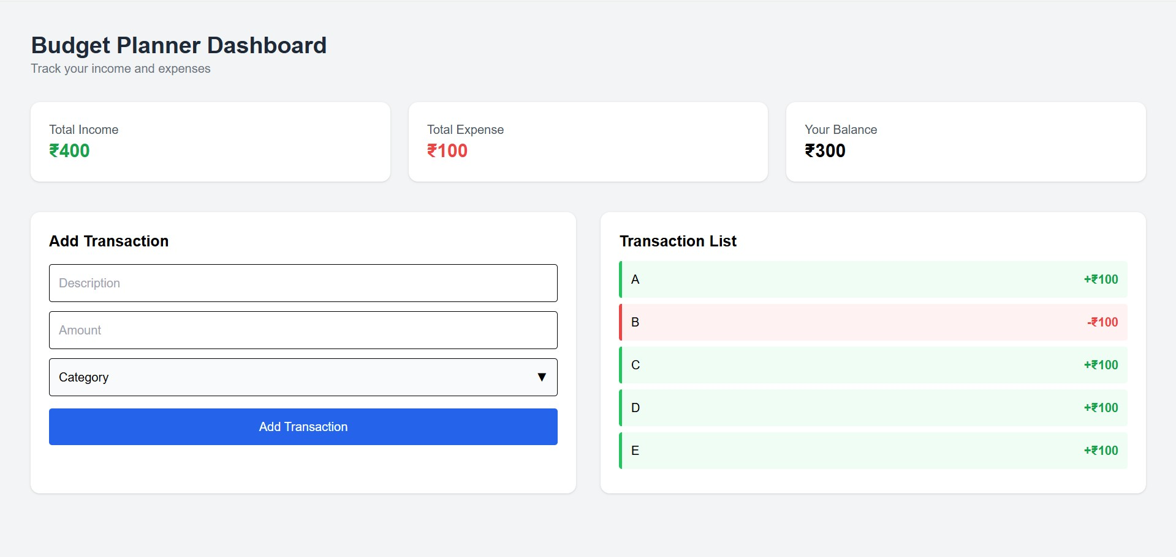
Current Status
Current Status
Completed Milestones:
UI/UX Framework (The dashboard interface is fully designed and visually representational).
Interface Components (“Add Transaction” form and “Transaction List” view are ready)
Visual Feedback (Dynamic styling for income(₹) and expenses(₹) is implemented in the UI)
Next Steps:
Backend Development (Building the Python Flask server to process input)
Data Persistence (Implementing storage so transactions remain after page refresh)
Calculation Logic (Linking the UI fields to functional mathematical operations)

Slide 8
Thank You

